Slide 1
IMPLEMENTING
CONTROLLER VIEW METHODS

Slide 2




BHUVANESH NAKKA
RAJESH KAMMARI
VAMSHI KRISHNA REDDY
YEDALLA
Valentine osakwe

Slide 3
CONTENTS
Web Application
Model
Views
Controller

Slide 4
Web Application
Web Application is a client Server computer program which the client (including the user interface and client-side logic) runs in a web browser .
The Model–view–controller shortly known as MVC is a software architectural design for implementing user interfaces on computers.
MVC patterns separate input, processing, and output of an application.

Slide 5
In MVC pattern, application and its development are divided into three interconnected parts.
The advantage of this is it helps in focusing on a specific part of the
Application the ways information is presented to and accepted from,
the user.
It helps in allowing for efficient code reuse and the parallel development
Of the application.

Slide 6
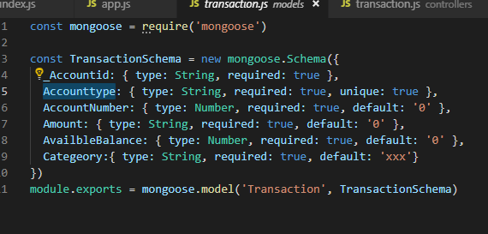
Model: Model represents the structure of data,the format and the constraints with which it is stored. It maintains the data of the application. Essentially, it is the database part of the application.

Slide 7
VIEWS
View: View is what is presented to the user.Views utilize the Model and present data in a form in which the user wants.
A user can also be allowed to make changes to the data presented to the user.
They consist of static and dynamic pages which are rendered or sent to the user when the user requests them.
Everything the user will see. Basically the pages that we’re going to send to the client.

Slide 8
CONTROLLERS
Controller:Controller controls the requests of the user and then generates appropriate response which is fed to the viewer.
The user interacts with the View, which in turn generates the appropriate request,this request will be handled by a controller.
The controller renders the appropriate view with the model data as a response.
Model is data part.
View is User Interface part. Controller is request-response handler.

Slide 9
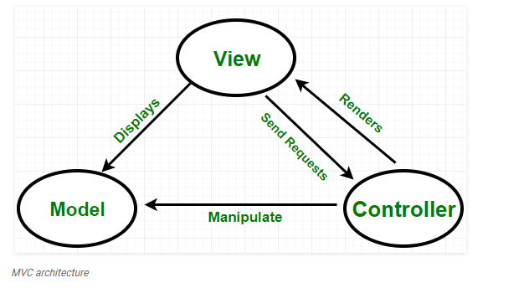
Source : geeksforgeeks

Slide 10
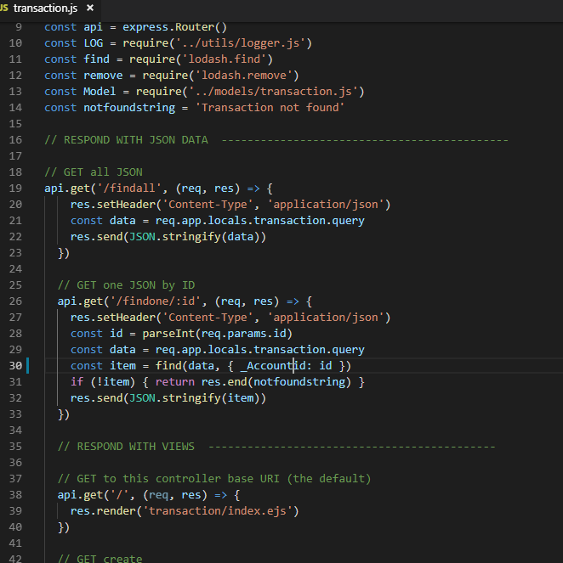
DEMO ON
CONTROLLER
VIEW METHODS

Slide 11
CONTROLLER : VIEW METHODS
View() | Creates a ViewResult object that renders a view to the response.
View(Object) | Creates a ViewResult object by specifying a model to be rendered by the view.
View(String) | Creates a ViewResult object by specifying a viewName.
View(String, Object) | Creates a ViewResult object by specifying a viewName and the model to be rendered by the view.

Slide 12
ANY QUERIES?

Slide 13

THANK YOU!

